Slide 1
State and Economy
Rafael Marques

Slide 2
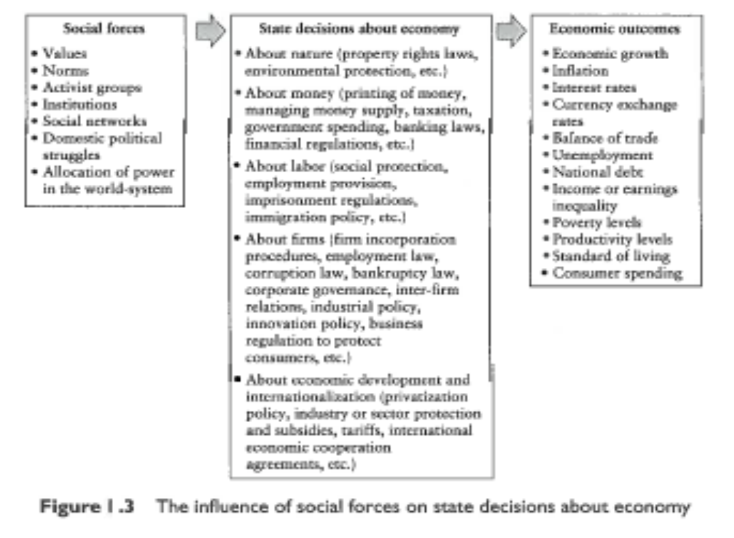
Introduction

Slide 3
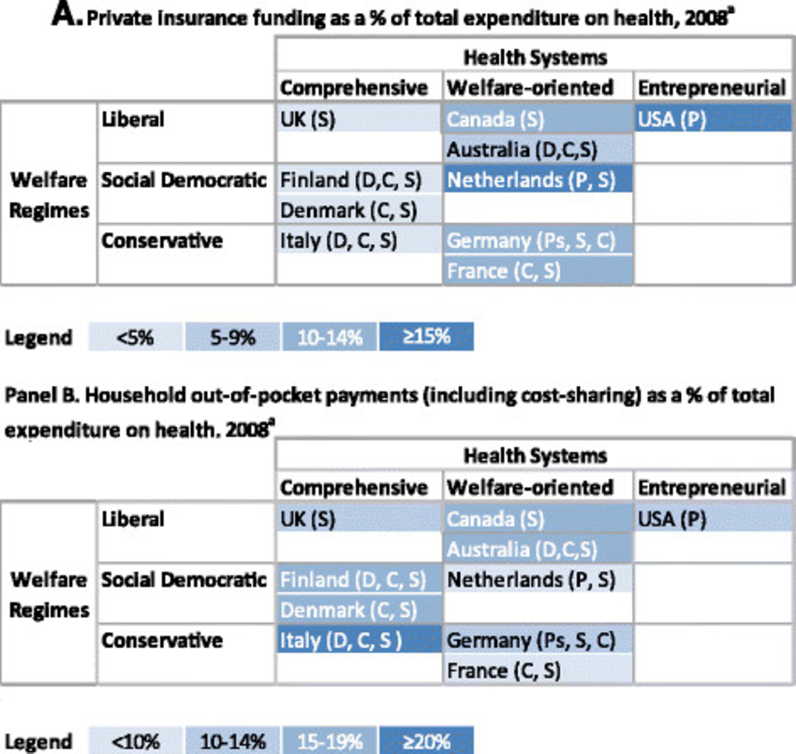
Three Worlds of Welfare State

Slide 4
Welfare State

Slide 5
Welfare State

Slide 6
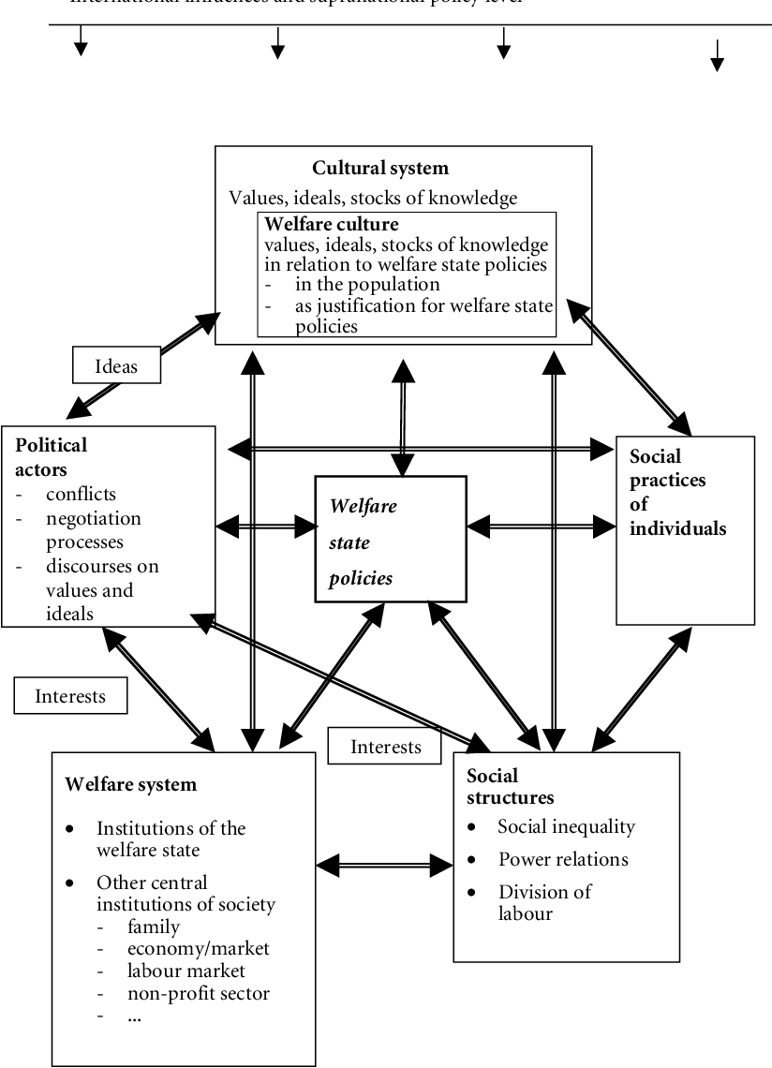
The Welfare System

Slide 7
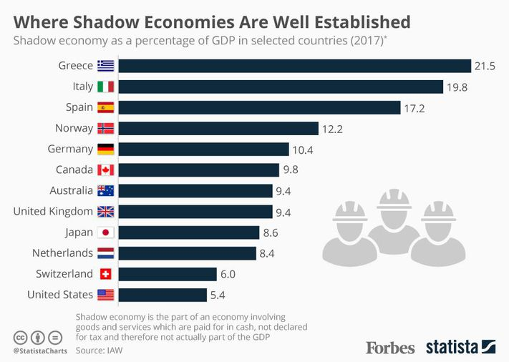
The Shadow Economy

Slide 8
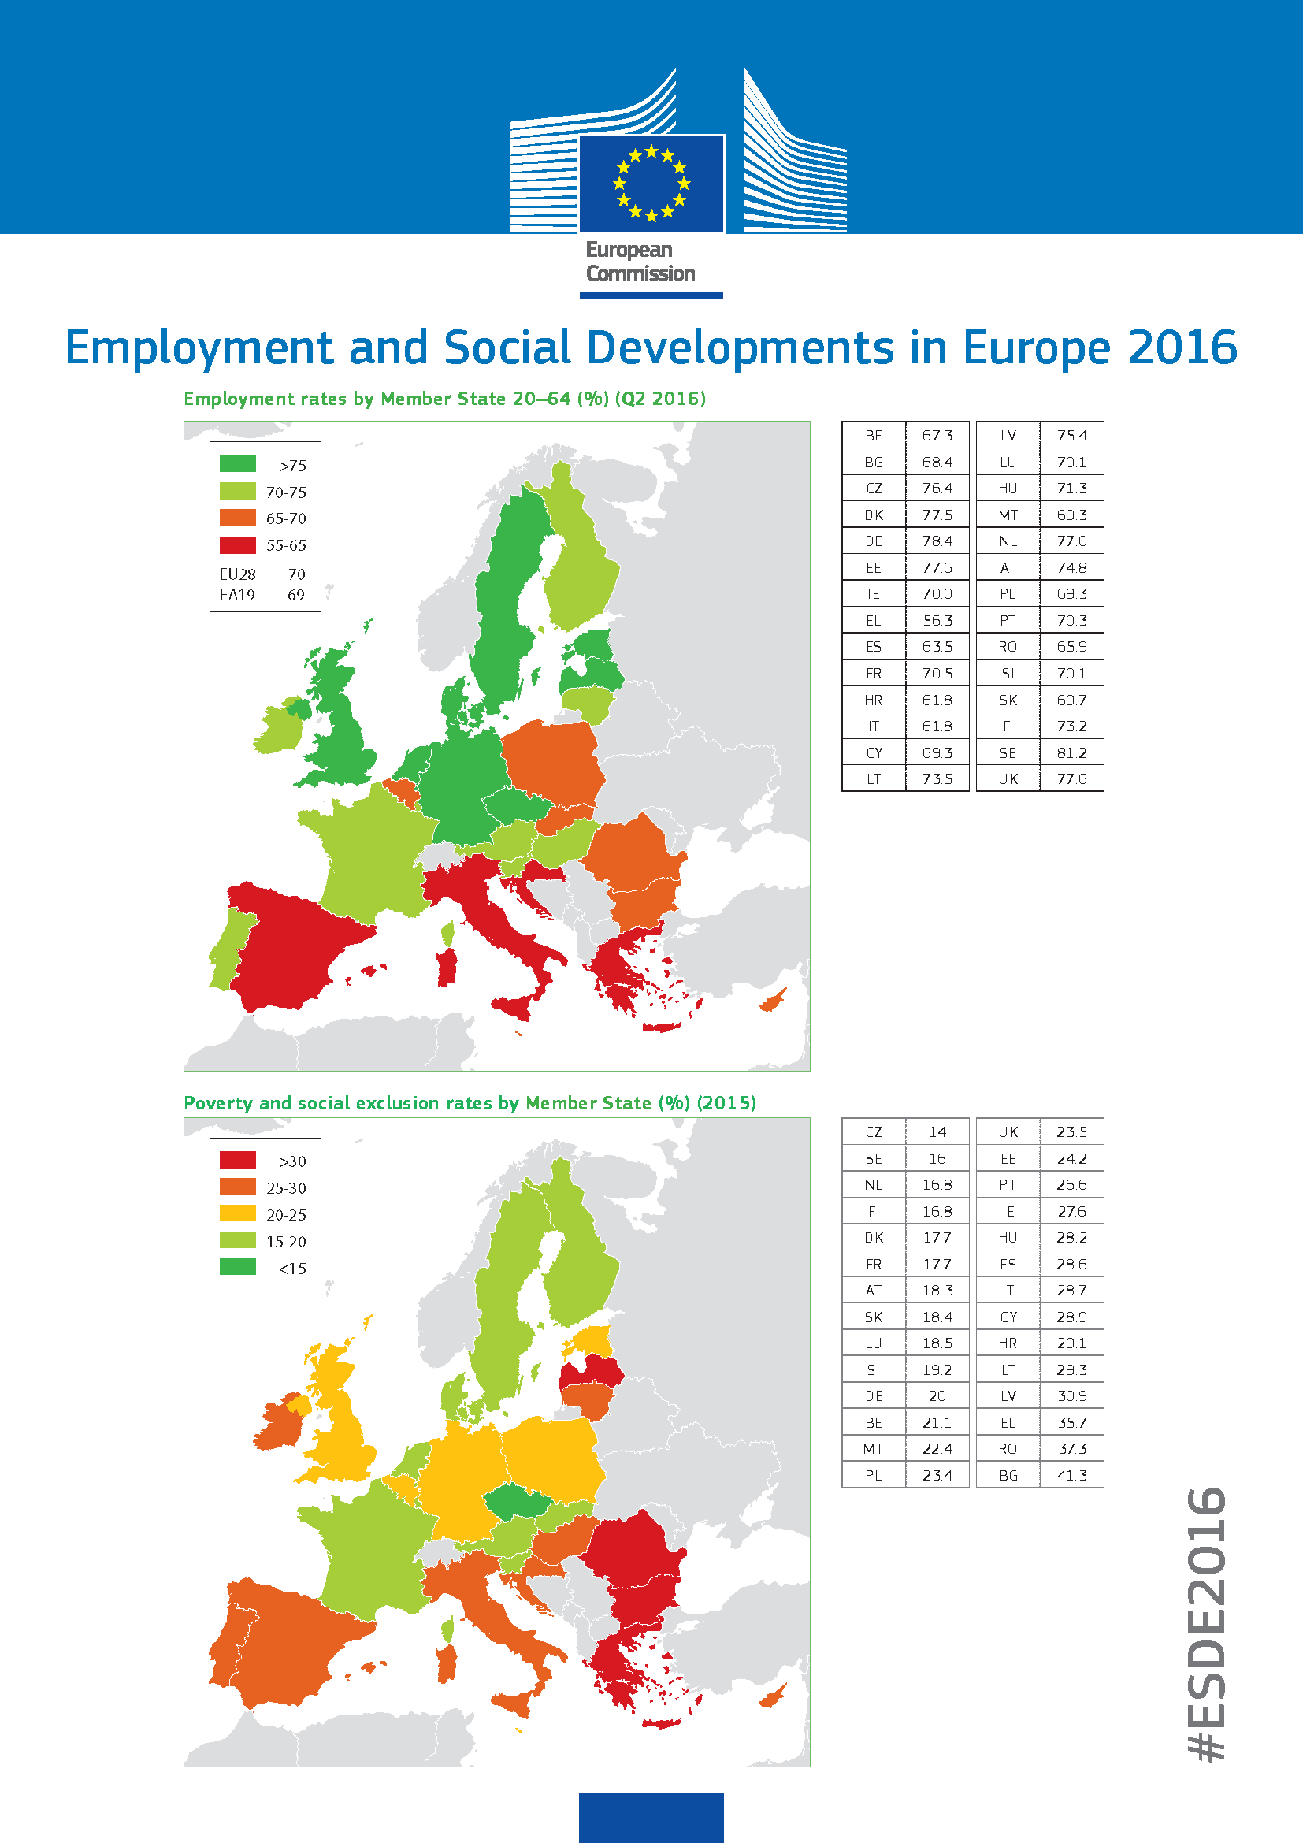
Shadow Economy, Employment,and Poverty in Europe

Slide 9
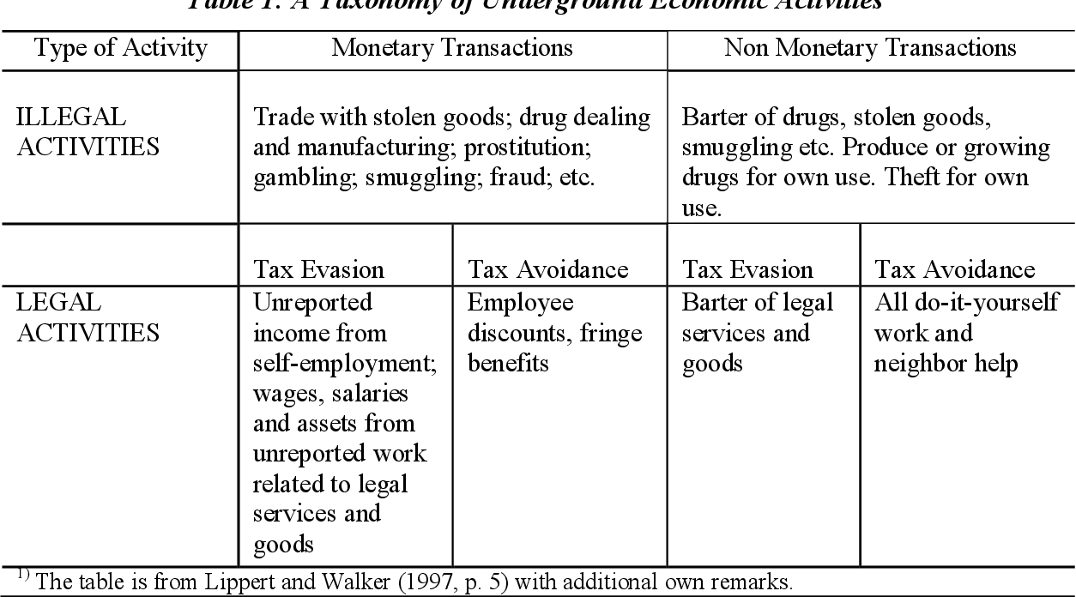
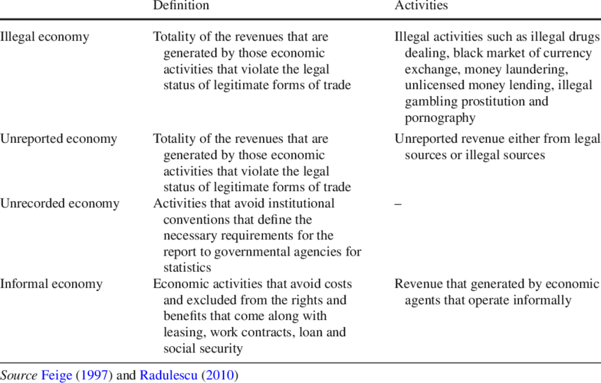
Shadow Economy

Slide 10
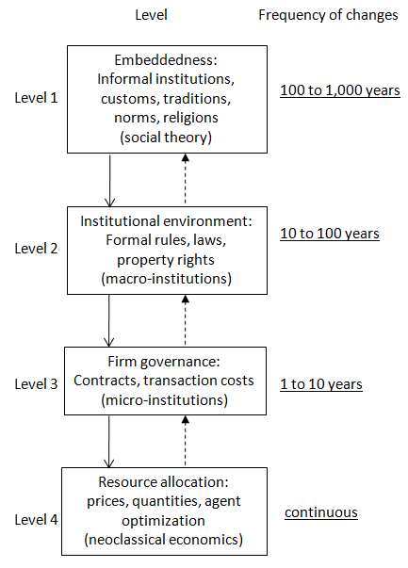
Informality

Slide 11
Taxation

Slide 12
Taxation

Slide 13
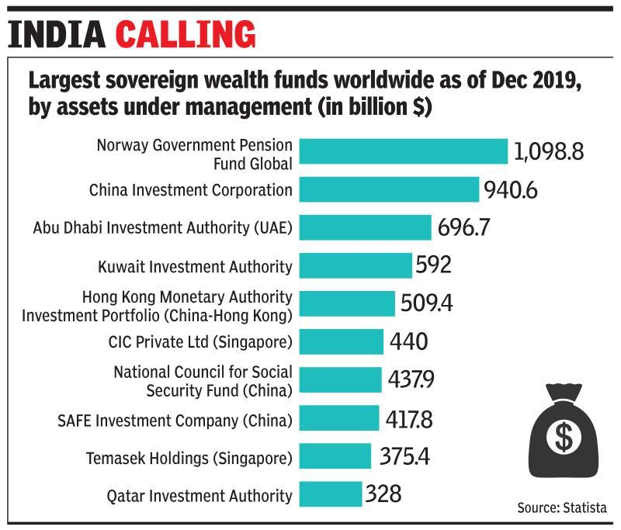
Sovereign Wealth Funds

Slide 14
Varieties of Capitalism

Slide 15
Varieties of Capitalism

Slide 16
Varieties of Capitalism

Slide 17
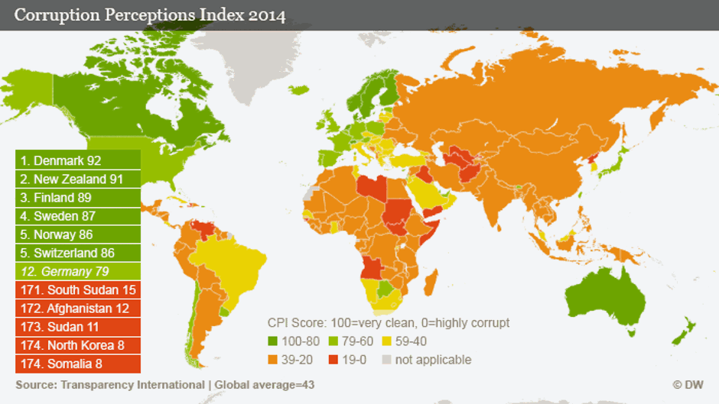
Crony Capitalism and Corruption

Slide 18
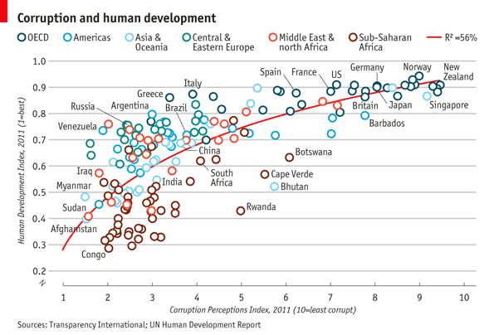
Corruption and Human Development

Slide 19
Development Models

